Slide 1
CARDIAC ANATOMY-II CORONARY ARTERIES, VENOUS DRAINAGE & CONDUCTION SYSTEM
CHAIR PERSON – DR.SAM JACOB,MD,DM.,
ASST PROFESSOR
PRESENTOR - DR.ARAVIND KUMAR K
SR CARDIOLOGY

Slide 2
REFERENCES:
Hurst’s The Heart,15th edition
Braunwald’s Heart diseases,a textbook of Cardiovascular Medicine ,12th edition
Gray’s Anatomy,41st edition
J. of Cardiovasc. Trans. Res. (2013) 6:197–207 DOI 10.1007/s12265-013-9452-5
ahajournals.org/ at University of Auckland on March 24, 2015, doi: 10.1161/01.CIR.0000028464.12047.A6
D. Korpas, Implantable Cardiac Devices Technology, DOI 10.1007/978-1-4614-6907-0_2, 7 © Springer Science+Business Media New York 2013
Corrigendum to “Cardiac veins, an anatomical review” [Transl. Res. Anat. 23C (2021) 100096]
Mohammad W. Kassem, Sasha Lake, Wallisa Roberts, Sonja Salandy, Marios Loukas https://doi.org/10.1016/j.tria.2020.100096

Slide 3
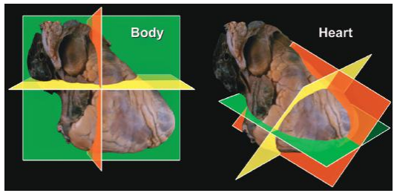
INTRODUCTION
All structures of our body are most effectively described following the convention of the anatomical position relative to the coordinates formed by the frontal, coronal, and sagittal planes of the body.
But the most popular names for cardiac structures are based on the “Valentine” arrangement, where the heart is considered as standing on its apex, rotated through approximately 45° in the right-to-left and postero-anterior planes relative to its position within the body

Slide 4
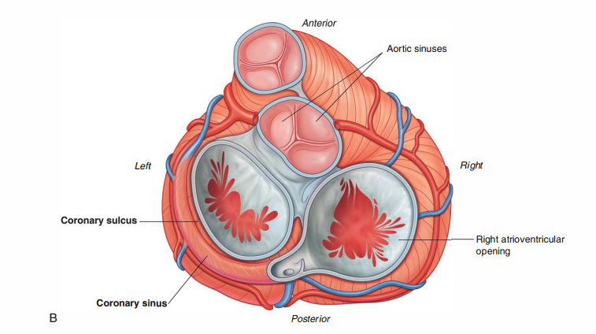
CORONARY ARTERY
2 coronary arteries
RIGHT CORONARY ARTERY
LEFT CORONARY ARTERY

Slide 5
SINUS OF VALSALVA & CORONARY ORIGIN
The right and left coronary arteries arise from the right and left aortic sinus, respectively.
Their ostia normally originate about two-thirds the distance from the aortic annulus to the sinotubular junction and about midway between the aortic valve commissures

Slide 6
The right coronary artery arises nearly perpendicularly from the aorta, the left arises at an acute angle
Ostial stenosis most commonly results from atherosclerosis and degenerative calcification of the aortic sinotubular junction, which often overlies the right aortic sinus.
Less often,it can also be caused by
aortic dissection
aortitis associated with syphilis or ankylosing spondylitis.

Slide 7
Stenosis of the right coronary ostium is much more frequent than that of the left.
Iatrogenic ostial injury can also be due to coronary angiography, intraoperative coronary perfusion, or aortic valve replacement.
Atherosclerosis or thrombosis of the most proximal portion of either coronary artery can mimic true
ostial stenosis.

Slide 8
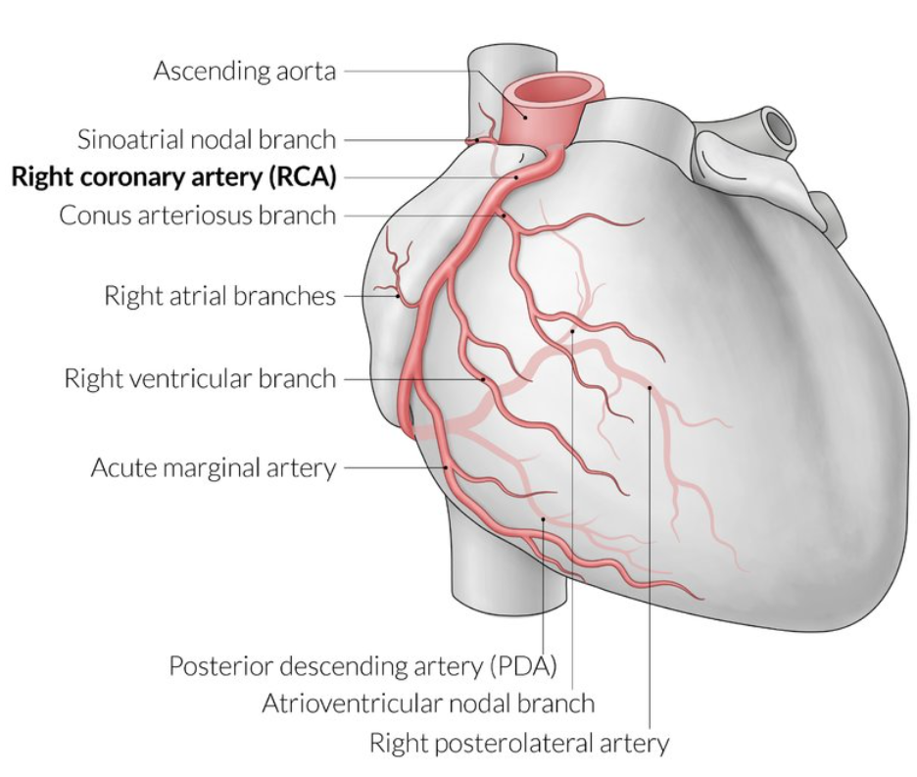
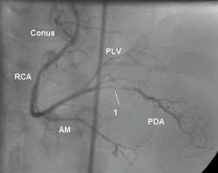
RIGHT CORONARY ARTERY
The right coronary artery is embedded in adipose tissue throughout its course within the right AV groove
It descends anteriorly and inferiorly to the right border of the heart, and issuing several branches before travelling posteriorly and inferiorly
Tricuspid annuloplasty or replacement can be complicated by injury to the right coronary artery

Slide 9
RCA BRANCHES

Slide 10
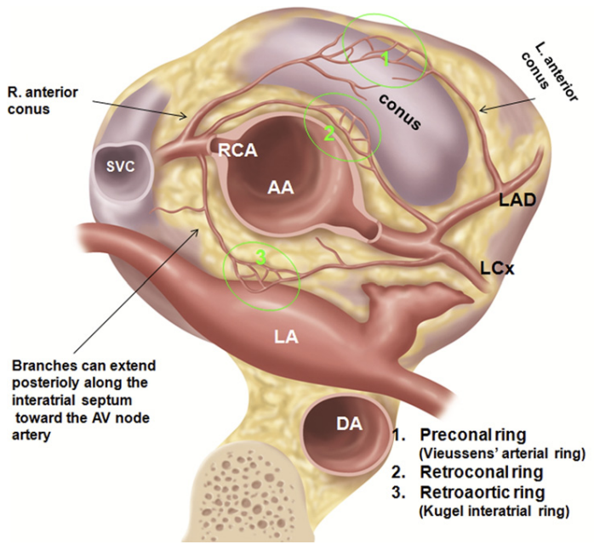
Conus artery(50-60%) - right ventricular outflow tract.
Forms an important collateral anastomosis (circle of Vieussens), just below the pulmonary valve, with an analogous branch from the left anterior descending (LAD) coronary artery
In one-third of patients, the conus artery arises independently from the aorta.

Slide 11
The infundibular septum is supplied by the descending septal artery, which usually originates from the proximal right or conus artery.
In 70% people, the posterior descending artery arises from the distal right coronary artery
The posterior descending and distal posterolateral branches of a dominant right coronary artery supply
basal and middle inferior wall,
basal (inlet) inferior septum,
right bundle branch, AV node, AV (His) bundle, posterior portion of the left bundle branch,
posteromedial mitral papillary muscle

Slide 12
3 LEVELS OF SHORT AXIS VIEWS

Slide 13
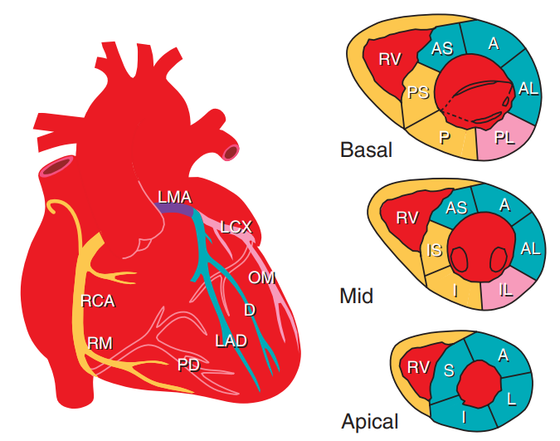

Slide 14
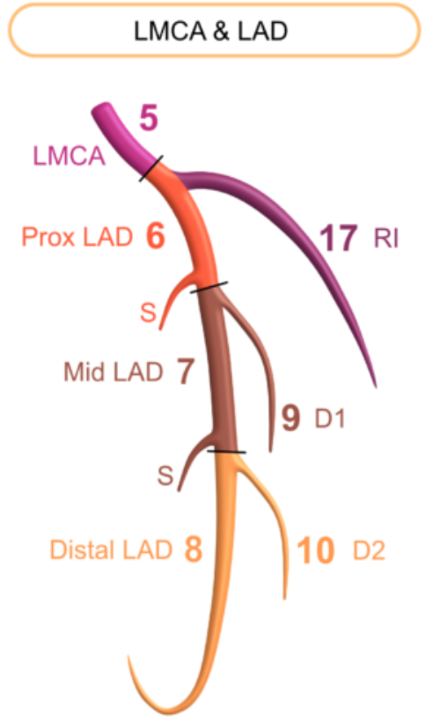
LEFT CORONARY ARTERY
The left main coronary artery travels for a very short distance along the epicardium between the pulmonary trunk and left atrium.
It then divides into anterior descending and circumflex arteries.
An intermediate artery (ramus intermedius) also may arise at this division, thus forming a trifurcation rather than a bifurcation, and follow the course of a circumflex marginal branch

Slide 15
LEFT ANTERIOIR DESCENDING ARTERY
The LAD courses within the epicardial fat of the anterior interventricular groove, wraps around the cardiac apex, and travels a variable distance along the inferior interventricular groove toward the cardiac base.
Its septal perforating branches supply the anterior septum and apical septum.
The first septal perforating branch supplies the AV (His) bundle and proximal left bundle branch

Slide 16
The epicardial diagonal branches of the LAD supply
the anterior left ventricular free wall,
part of the anterolateral mitral papillary muscle,
medial one-third of the anterior right ventricular free wall.

Slide 17
CLINICAL IMPORTANCE
In patients with symptomatic hypertrophic obstructive cardiomyopathy(HOCM),
Nonsurgical septal reduction by percutaneous transluminal occlusion of septal branches of the LAD is a therapeutic approach aimed at reducing the outflow gradient.
The septal perforating branches can be accidentally ligated during the Ross procedure, in which the infundibular sleeve of the pulmonary trunk is utilized as an autograft for the aortic valve

Slide 18
The most prominent branch ,left descending septal artery, or artery to the moderator band, which supplies the latter structure before terminating at the anterior papillary muscle.
Obstruction of this vessel can result in right bundle branch block, anterior septal infarction, or a combination of both.

Slide 19
LEFT CIRCUMFLEX ARTERY
The left circumflex coronary artery courses within the adipose tissue of the left atrioventricular groove
It commonly terminates just beyond its large obtuse marginal branch.
It supplies the lateral left ventricular free wall and a portion of the anterolateral mitral papillary muscle.
Along the inferior surface of the heart, the length of the right coronary artery varies inversely with that of the circumflex artery.

Slide 21
DOMINANCE SYSTEM
The artery that crosses the cardiac crux and gives rise to the posterior descending branch represents the dominant coronary artery.
Dominance is right in 70% of human hearts, left in 10%, and shared in 20%.
In patients with a congenitally bicuspid aortic valve, the incidence of left coronary dominance is 25% to 30%.

Slide 22
CORONARY ANOMALIES

Slide 23
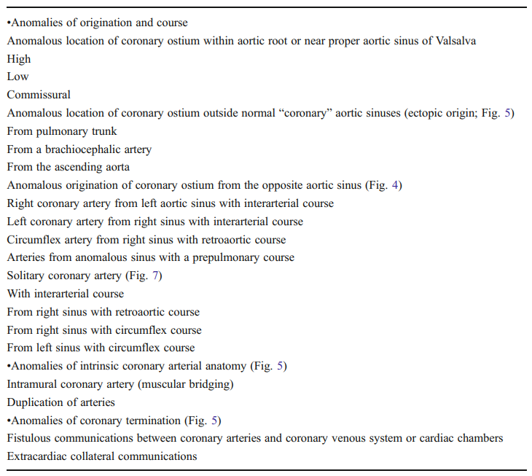

Slide 25
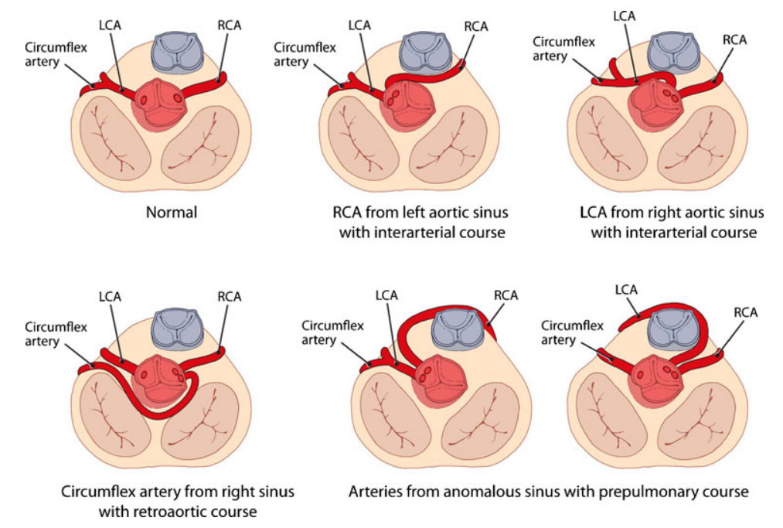

Slide 28
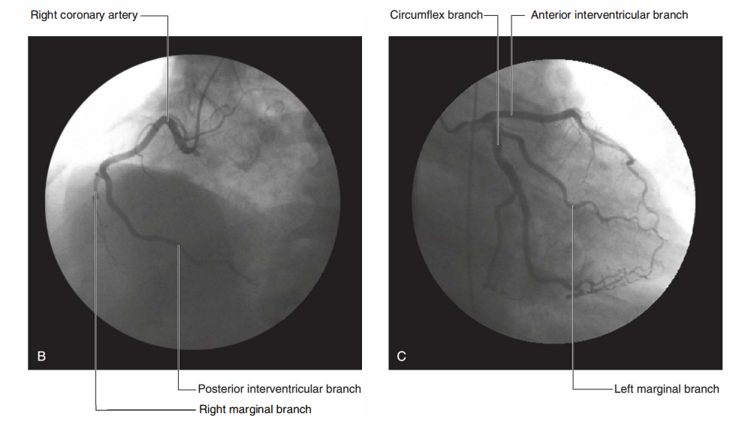
CORONARIES IN CAG

Slide 29
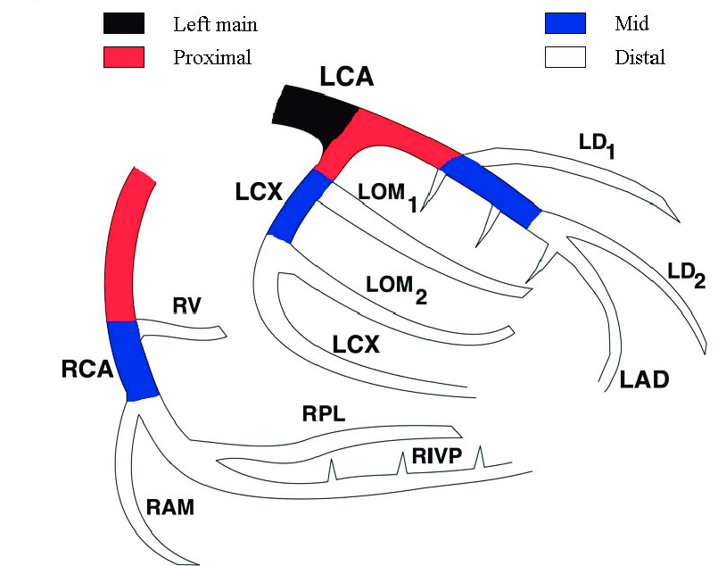

Slide 32
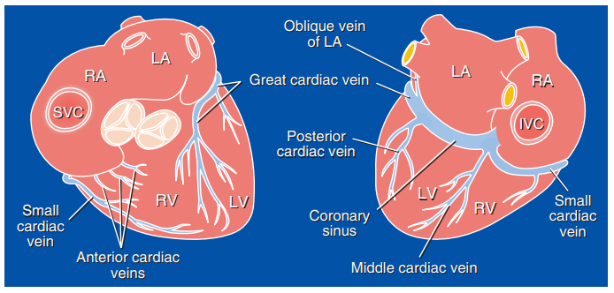
VENOUS DRAINAGE OF HEART & EP APPLICATIONS

Slide 33
CLASSIFICATION OF CARDIAC VEINS
Topographical classification
Modern classification
Segmental classification

Slide 34
TOPOGRAPHICAL CLASSIFICATION
3 groups
coronary sinus & its tributaries
Anterior cardiac veins – myocardium
Thebesian veins –sub endocardium and intra mural part of myocardium

Slide 35
MODERN CLASSIFICATION
Greater venous system – Coronary sinus and its tributaries
Drains sub epicardial myocardium
Lesser venous system – Smaller cardiac veins /Thebesian veins
These are thin walled which directly opens into cardiac chambers

Slide 36
SEGMENTAL CLASSIFICATION
This categorizes the cardiac venous drainage by the region of the myocardium that it drains.
Using this classification of naming, the focus can be on regional topography, such as the right or left ventricle.
This type of classification is important to the electrophysiologist who is particularly concerned with the left-side of the myocardium for left ventricular lead placement
This classification system separates the left sided cardiac veins in accordance with the anatomic course of the tributaries, that is, the short and long axis(3×3 regions of LV)

Slide 37
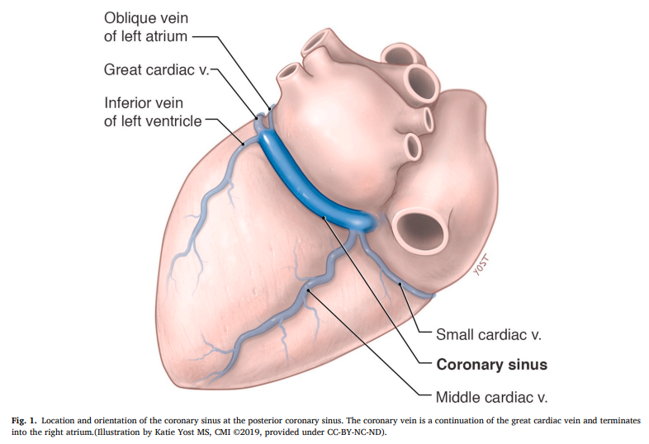
CORONARY SINUS
The coronary sinus starts at the site of origin of the valve of Vieussens {at the junction of the great cardiac vein and the oblique vein of the left atrium (vein of Marshall) } and ends at the right atrial orifice
The coronary sinus measures approximately 10 mm in diameter and 40 mm in its length, roughly the size of the fifth human digit
The coronary sinus ostium, the orifice of the coronary sinus, has a diameter that ranges widely from 5 to 15 mm

Slide 38
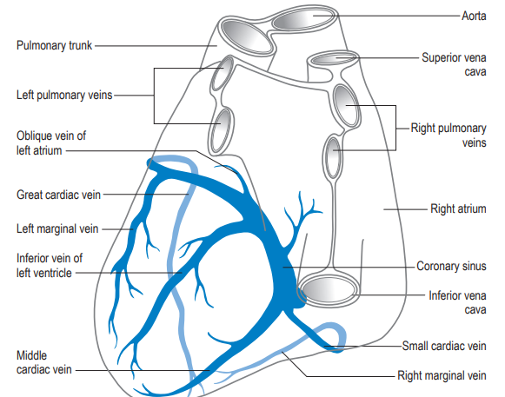
TRIBUTARIES OF CS
Great cardiac vein
Middle cardiac vein
Small cardiac vein
Oblique vein of Marshall
Posterior vein of the left
ventricle
Indirect tributaries:
Left marginal vein
Right marginal vein
Anterior cardiac vein

Slide 39
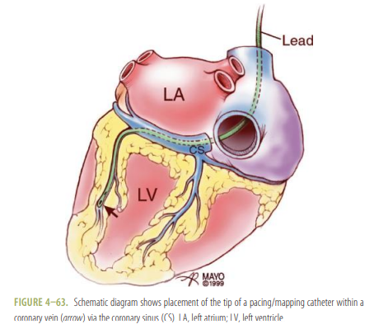
Clinical significance:
The coronary sinus access is very much useful in interventions such as
Catheter ablation of arrhythmias,
Cardiac resynchronization therapy,
retrograde cardioplegia delivery,
Arrhythmia mapping,
Percutaneous mitral annuloplasty

Slide 40
In patients with the WPW preexcitation syndrome and left-sided bypass tracts, the ablation catheter during electrophysiologic studies can be positioned within the coronary sinus and great cardiac vein adjacent to the mitral valve ring to localize the aberrant conduction pathway.
The coronary veins, via the coronary sinus, provide access to percutaneous epicardial mapping and pacing of the ventricles and ablation of subepicardial arrhythmogenic foci.
For biventricular pacing, optimal left ventricular pacing lead position is within the posterolateral branch of the coronary sinus, followed by the lateral branch

Slide 41
Importance of Thebesian Valve:
Studies have identified a cannulation failure rate as high as 2.6% because of an obstructing Thebesian valve
When performing radiofrequency ablation to treat atrial flutter and atrial fibrillation, retrograde cardioplegia administration is achieved through accessing the coronary sinus.
Being familiar with the presence of the Thebesian valve is critical to ensure proper ablation of all target tissue.

Slide 42
36/Male, a case of WPW, taken for EPS. Findings?
RA
HIS
CS
RV

Slide 43
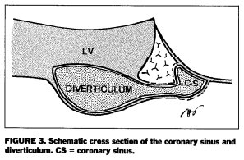

Slide 45
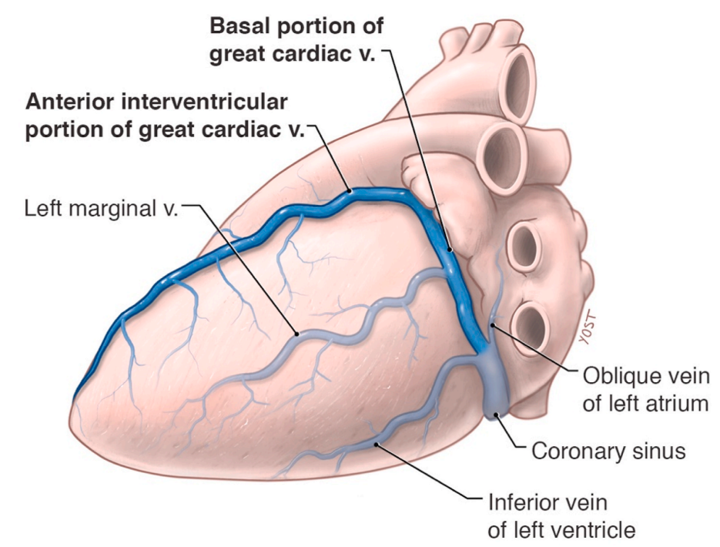
GREAT CARDIAC VEIN
The longest venous vessel of the myocardium and most constant one
The great cardiac vein tributaries are collectively responsible for the drainage of
the left atrium,
the anterior wall of the right and left ventricle,
apical regions of the myocardium and the interventricular septum
Its tributaries are from the left atrium, left and right ventricles, and left marginal vein
The valve of Vieussens is clinically relevant for the practitioner because of its variability and its obstruction to leads and catheters placed during cardiac procedures

Slide 46
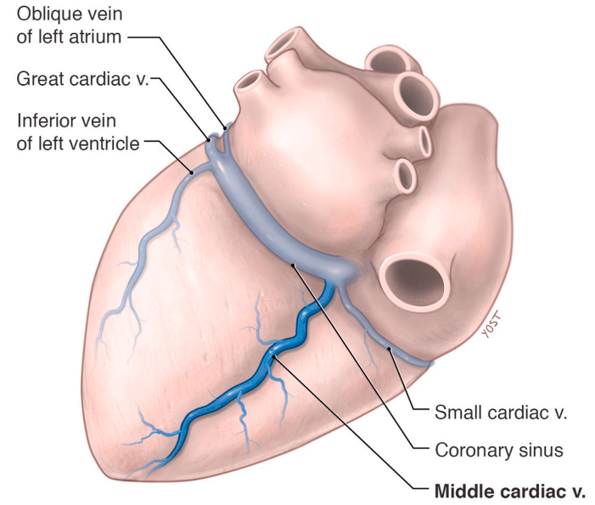
MIDDLE CARDIAC VEIN
The middle cardiac vein, also known as the inferior interventricular vein
It drains the ventricular septum and the diaphragmatic portions of the walls of the cardiac ventricles
The venous confluence is the location of most aneurysms in the cardiac venous system.
Such coronary sinus -confluence aneurysms are associated with cardiac arrhythmias

Slide 47
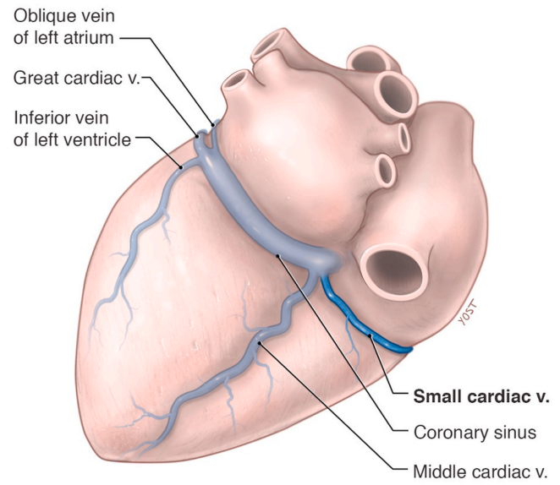
SMALL CARDIAC VEIN
The small cardiac vein, or the right coronary vein, is a small tributary of the coronary sinus, originating from the inferior part of the right coronary sulcus
The small cardiac vein drains the inferior and lateral walls of right ventricle

Slide 48
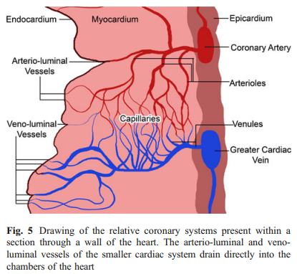
SMALLER CARDIAC VENOUS SYSTEM
Smaller cardiac (venae cordis minimae; Thebesian) veins, opens into all cardiac cavities
Four types of Thebesian veins have been described;
Venoluminal veins drain directly into the cardiac chambers
Venosinusoidal veins drain into subendocardial sinusoids (which, in turn, drain into the cardiac chambers)
Arterioluminal veins connect small arteries and arterioles directly with the cardiac chambers;
Arteriosinusoidal veins connect thin arteries or arterioles with subendocardial sinusoidal spaces

Slide 49
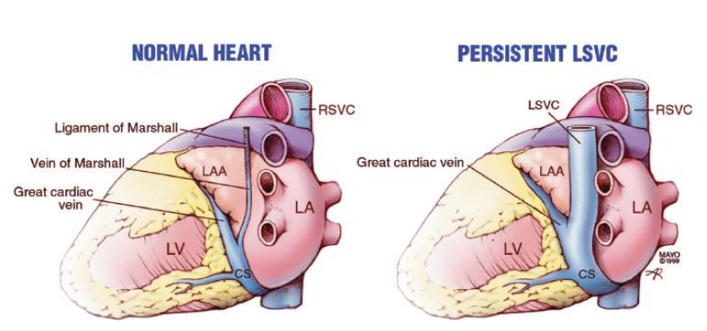
OBLIQUE VEIN OF MARSHALL & MARSHALL LIGAMENT
Marshall’s ligament - ectopic focus for triggering paroxysmal atrial fibrillation that can be treated with pulmonary ablation.
A left superior vena cava is the direct result of the failure of regression of the left anterior cardinal vein, which would normally form the ligament of Marshall .
The presence of a persistent left superior vena cava can render access to the right side of the heart difficult via the left subclavian.

Slide 50
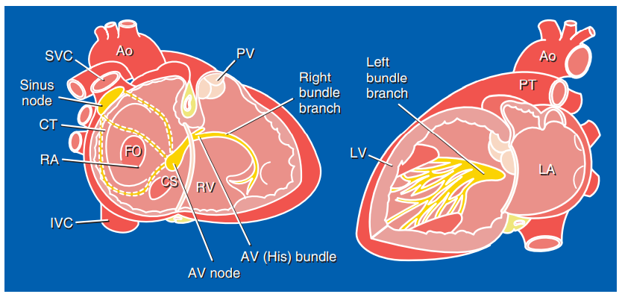
CARDIAC CONDUCTION SYSTEM & PACING APPLICATIONS

Slide 51
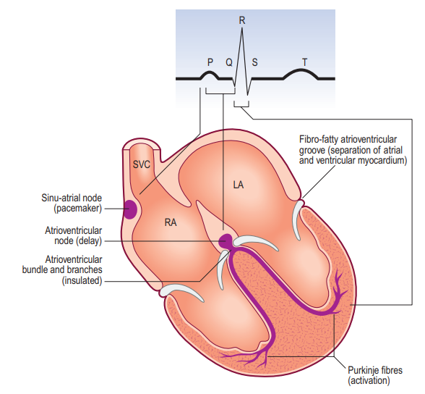
COMPONENTS
The cardiac conduction system consists of
Sinus node
Internodal tracts
AV node
AV (His) bundle
Right and Left bundle branches
Purkinje fibres

Slide 52
SA NODE
The sinus node is located subepicardially in the terminal groove, close to the junction between the superior vena cava and right atrium.
The sinus node artery arises from the right coronary artery in 55% of persons.
Its course can place it in contact with the base of the right atrial appendage and the superior vena cava–right atrial junction
When the sinus node artery arises from the left circumflex artery (45%), it can course close to the left atrial appendage

Slide 53
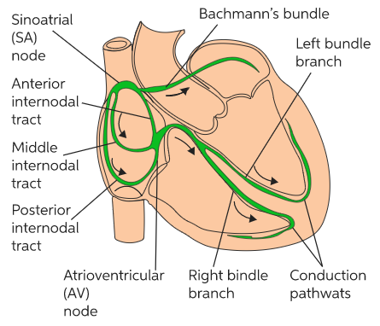
CLINICAL SIGNIFICANCE
During surgical operations such as the Mustard and Fontan procedures, the sinus node and its artery are susceptible to injury.
Electrophysiological studies support the concept of functional preferential pathways that travel along the crista terminalis and atrial septum including the limbus but not the valve of the fossa ovalis.
Internodal conduction disturbances therefore are not expected in transseptal procedures.

Slide 54
With the Mustard operation for complete transposition of the great arteries, there can be severe disturbance of internodal conduction because the entire septum is resected, and the surgical atriotomy can disrupt the crista terminalis.
Lipomatous hypertrophy of the atrial septum can interfere with internodal conduction and induce a variety of atrial arrhythmias.
Ventricular preexcitation is most commonly associated with aberrant bypass tracts that span the annulus of the tricuspid or mitral valve

Slide 55
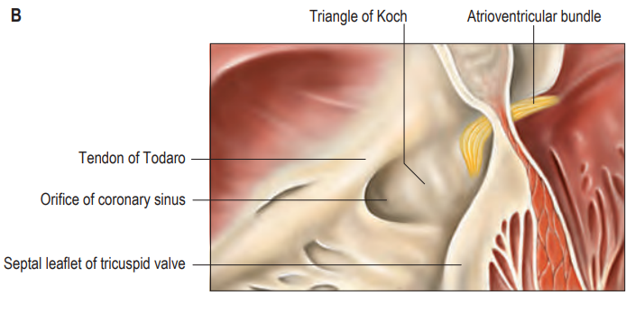
AV NODE
The AV node, in contrast to the sinus node, is a subendocardial structure that is located within
the triangle of Koch.
The boundaries of triangle of Koch include
Septal leaflet of the tricuspid valve anteriorly
Tendon of Todaro posteriorly.
Coronary sinus ostium forms the base of the triangle.
The membranous septum forms the apex
The floor - the RA septal myocardium(separated from the muscular ventricular septum)

Slide 56
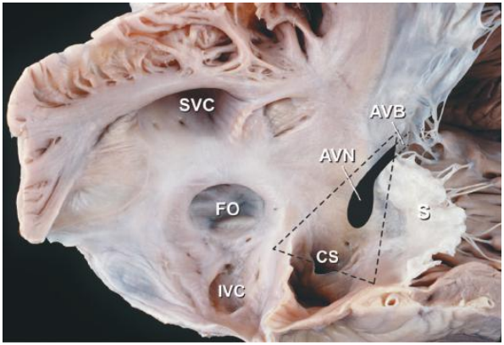
CLINICAL IMPORTANCE
Because of its right atrial location near the tricuspid annulus, the AV node is susceptible to injury during tricuspid annuloplasty and during plication procedures for Ebstein anomaly.

Slide 57
BUNDLE OF HIS
The AV (His) bundle arises from the distal portion of the AV node and travels along the ventricular septum adjacent to the membranous septum
The AV bundle receives a dual blood supply from the AV nodal artery and the first septal perforator of the left anterior descending coronary artery
The AV conduction tissue is generally remote from the defect in the outlet, inlet, and muscular forms of ventricular septal defect but travels along the inferior margin of a membranous ventricular septal defect.
In normal hearts, the AV bundle courses along the posteroinferior rim of the membranous septum but it courses along the anterosuperior rim of the membranous septum in hearts with AV discordance.

Slide 58
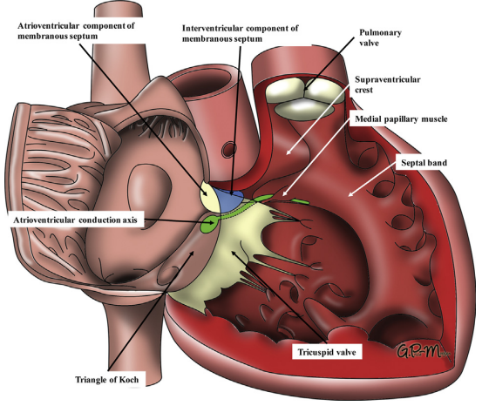
AV BUNDLE AND VSD

Slide 59
CLINICAL IMPORTANCE
The AV bundle travels through the central fibrous body (right fibrous trigone) and therefore is closely related to the annuli of the aortic, mitral, and tricuspid valves.
Thus, during operative procedures involving these valves or a membranous ventricular septal defect, care must be taken to avoid injury to the His bundle.

Slide 60
BUNDLE BRANCHES
The right bundle branch emanates from the distal portion of the AV bundle and forms a thin cord-like structure that travels along the septal and moderator bands toward the anterior tricuspid papillary muscle
In contrast, the left bundle branch represents a broad fenestrated sheet of subendocardial conduction fibers that spread along the septal surface of the left ventricle
The right and left bundle branches receive dual blood supply from the septal perforators of the LAD and posterior descending coronary artery.

Slide 61
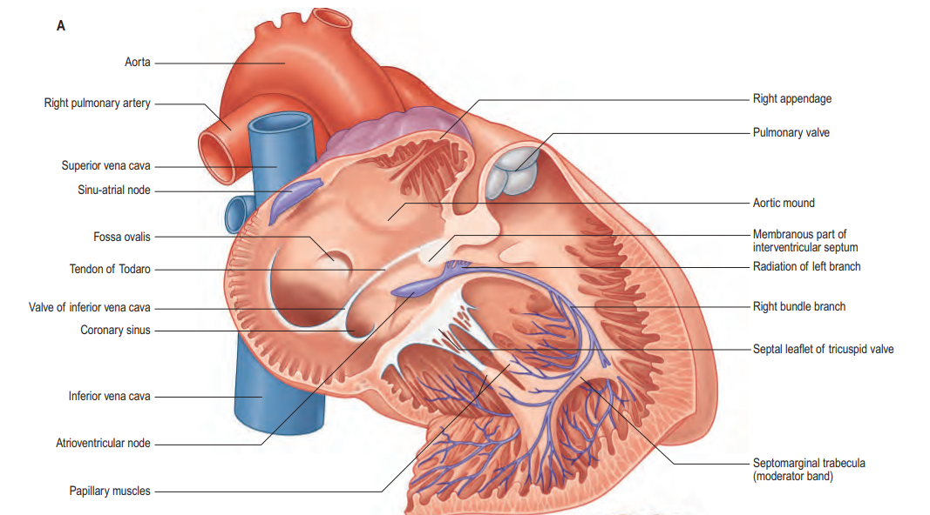
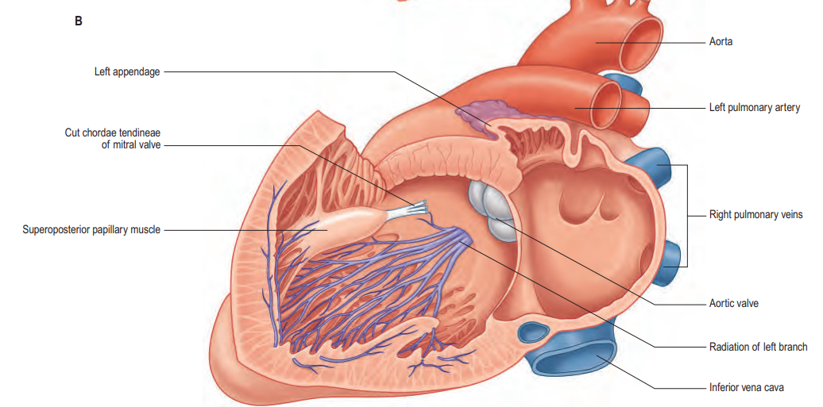

Slide 62
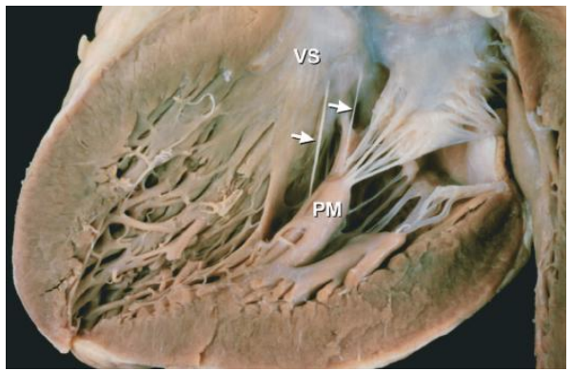
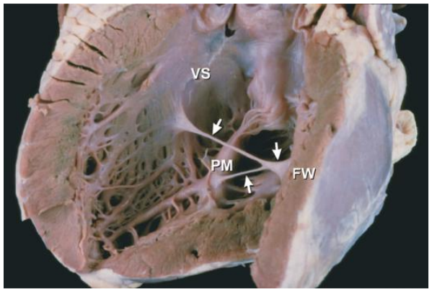
CLINICAL IMPORTANCE
Left ventricular pseudotendons can contain conduction tissue from the left bundle branch.
The left bundle branch can be disrupted following surgical myectomy, whereas the right bundle branch can be damaged during percutaneous alcohol septal ablation.
Following right ventriculotomy for reconstruction of the right ventricular outflow tract, the electrocardiogram shows a pattern of right bundle-branch block even though the right bundle is not disrupted.

Slide 63
CONDUCTION SYTEM PACING
Conduction system pacing (CSP), including His bundle pacing (HBP) and left bundle branch area pacing (LBBAP), is the most physiological of all pacing modalities for ventricular capture and a potential alternative to right ventricular pacing.
RV pacing induces electrical and mechanical dyssynchrony, resulting in left ventricular dysfunction, heart failure hospitalization, and atrial arrhythmia.
CSP activates the normal conduction system and restores ventricular synchrony.

Slide 64
LBAP AND HBP
A lower capture threshold was obtained at implantation and preserved during the follow-up period in patients with LBBAP.
The LBBAP is an alternative pacing form that overcomes the limitations of the HBP.
Cardiac resynchronization therapy with HBP or LBBAP may provide better synchronization than the traditional biventricular pacing.
Hybrid therapy utilizing HBP or LBBAP in combination with left ventricular pacing has been introduced to treat patients with heart failure.

Slide 65
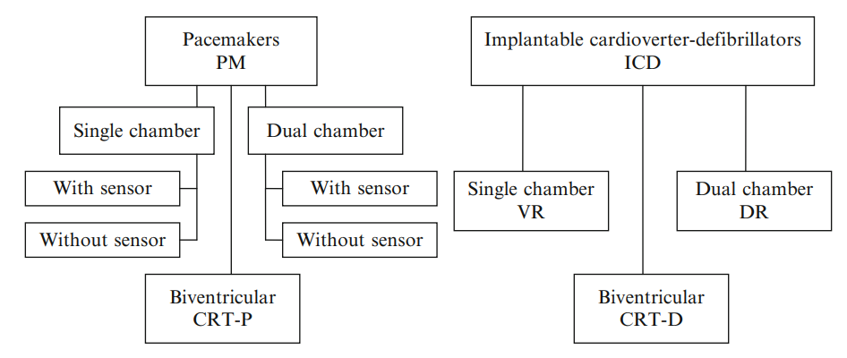
DIVISION OF IMPLANTABLE CARDIAC DEVICES

Slide 66
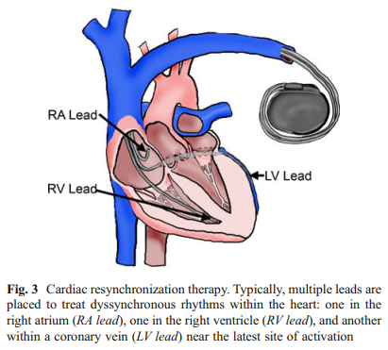

Slide 68
